Slide 1
BRIGHT ACADEMY ONLINE COURSEs
BY
SHALINI SHREE
VOORA YUGANDHAR
SUNKU RANGA PRABHAS
RATHINAVEL
JEYA PRIYA

Slide 2
CONTENT
INTRODUCTION
OBJECTIVES
ER DIAGRAM
FEATURES
TECHINICALS AND FRAMEWORK
TIMELINE
CONCLUSION

Slide 3
INTRODUCTION
BRIGHT ACADEMY is a online website where customer can get online course and books .
This application is to help the students to improve their skills in online.
Any user can purchase the available courses in our application
. Users can easily register into this application as it is made as easy as possible.
Our Application reduces the time and effort of tuitions and book shops.

Slide 4
objectives
In this BRIGHT ACADEMY any user can purchase the available Courses in our application.
We will provide cheep and best courses .
We created this web application to make cost effectively and user friendly.

Slide 5
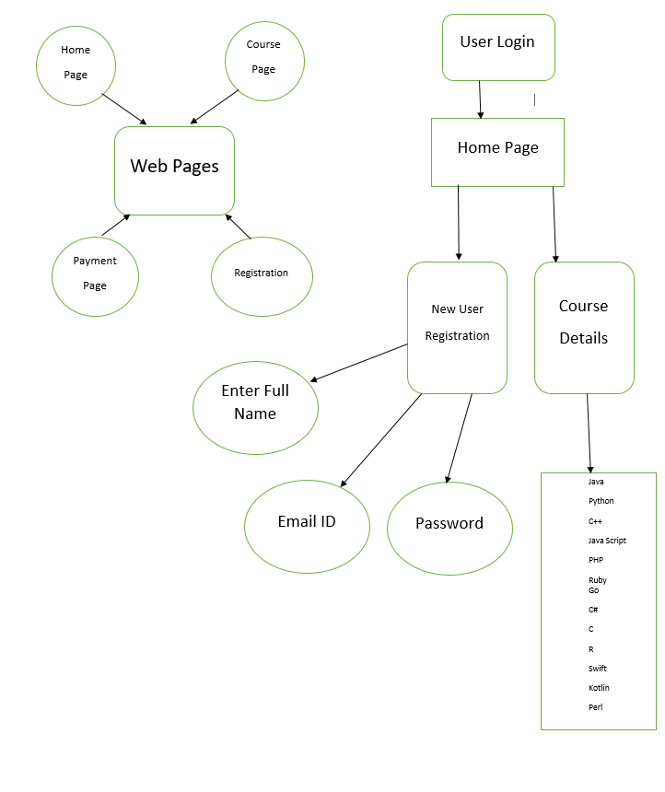
ENTITY RELATIONSHIP DIAGRAM

Slide 6
FEATURES
REGISTERATION page
LOGIN page
Home page
COURSE Details
About the Course
PAYMENT method
About us

Slide 7
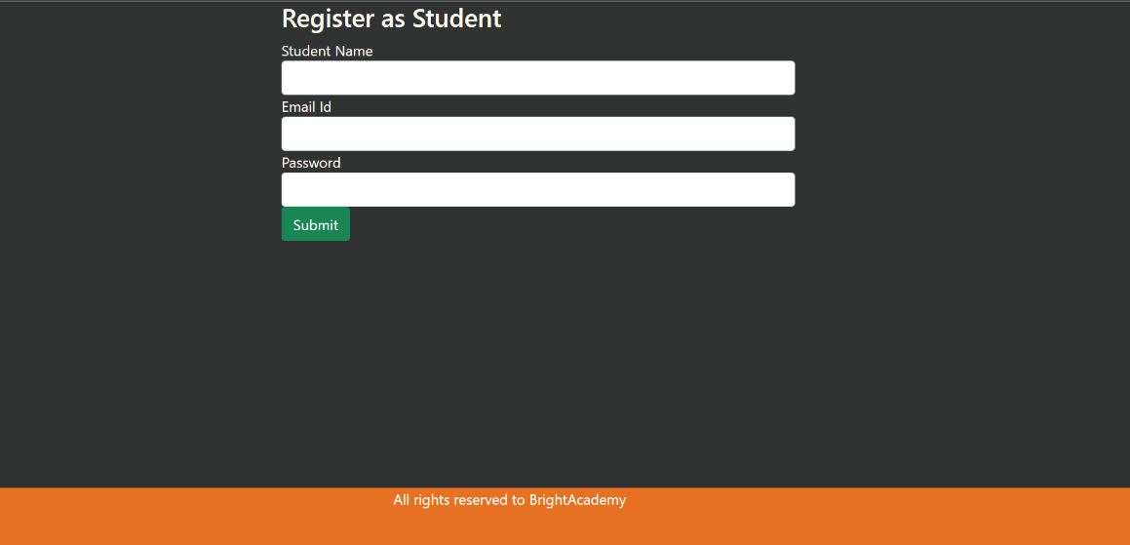
Registration page

Slide 8
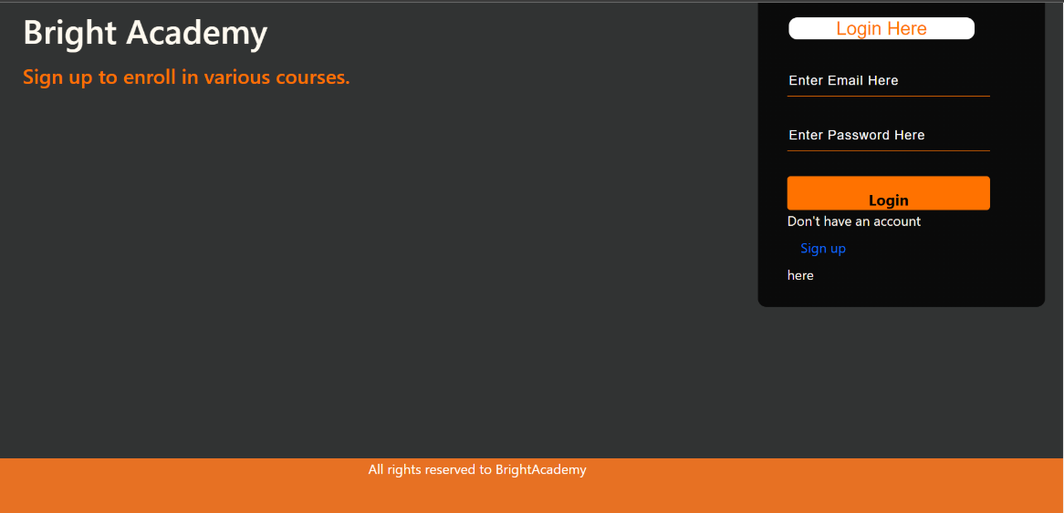
Login page

Slide 9

Home page

Slide 10
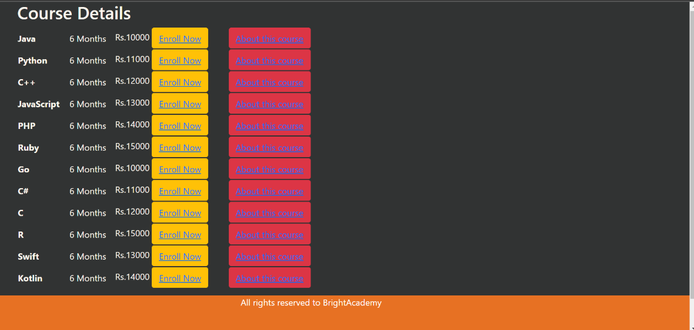
Courses details

Slide 11
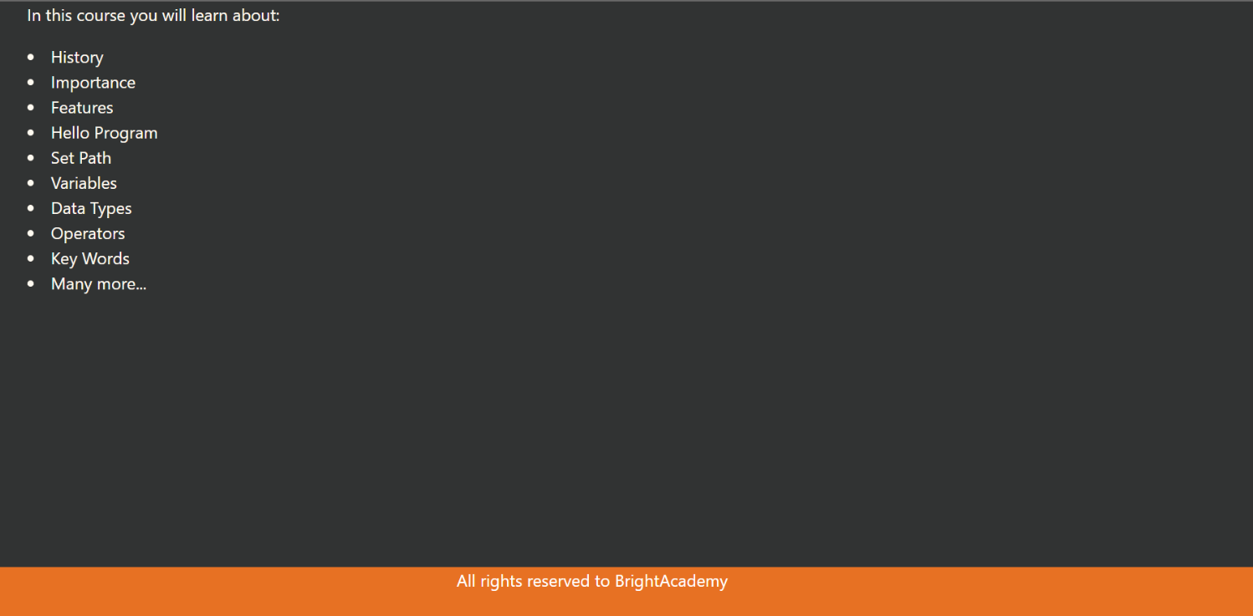
Course Details

Slide 12
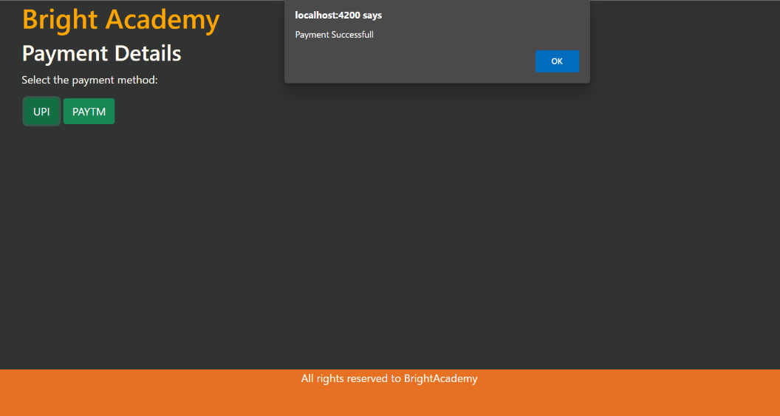
Payment method

Slide 13
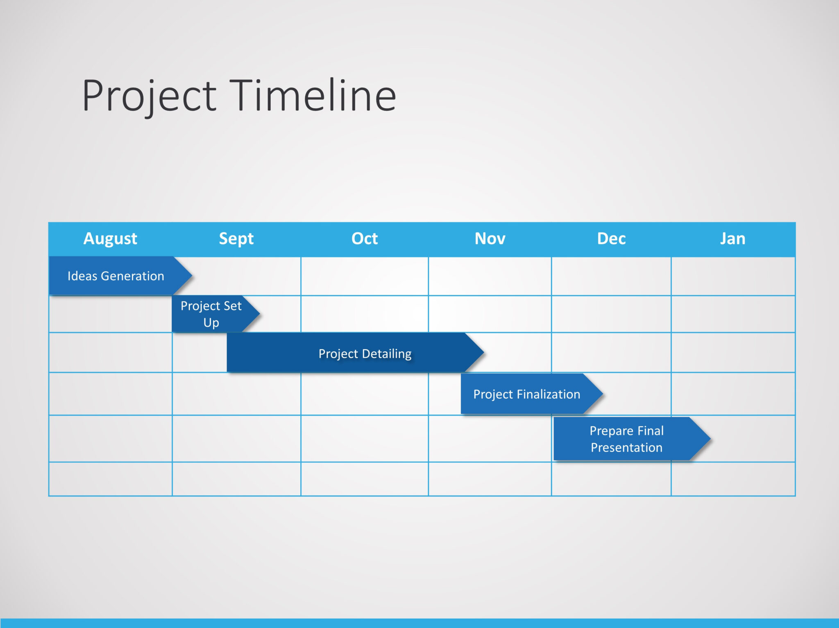
Time line

Slide 14
TECHINICALS AND FRAMEWORK
Database: Oracle 11g Express
Backend: Spring boot(Eclipse)
Front end: Angular
Languages used : 1. TypeScript
2. JavaScript
3.HTML
4.CSS (BootStrap)
5.Java
6. PL / SQL

Slide 15
Conclusion
The concept of traditional education has changed radically within the last couple of years. Being physically present in a classroom isn’t the only learning option anymore — not with the rise of the internet and new technologies, at least. Nowadays, you have access to a quality education whenever and wherever you want, as long as you can get online. We are now entering a new era — the revolution of online education.
In this BRIGHT ACADEMY any user can purchase the available Courses in our application.
We will provide cheep and best courses .
We created this web application to make cost effectively and user friendly.

Slide 16
Thank you

